Slide 1

Veeva Project Presentation

Slide 2
目 录
CONTENTS
Salesforce Introduction
Project Summary
Project Solution
Solution Detail

Slide 3
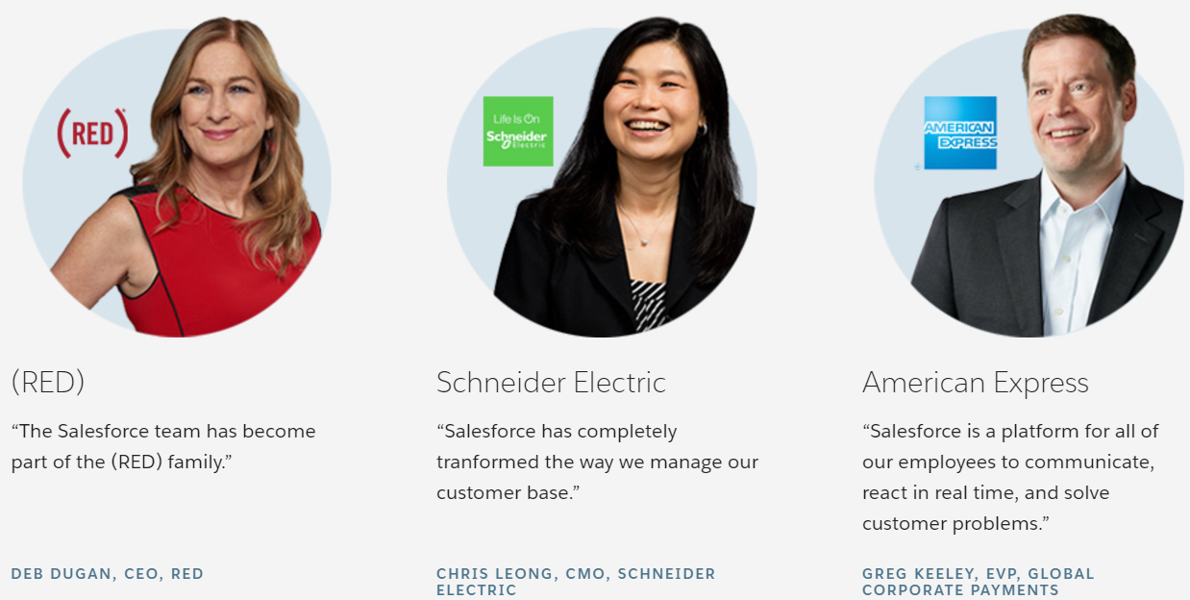
Why Salesforce CRM
Customer relationship management (CRM) manages your business's single most important goal - satisfying your customers. A highly effective customer relationship management system will encompass and enhance all aspects of customer interface, from sales and marketing to customer service : existing client relationships become stronger and new client relationships evolve more quickly - all core requirements of business success. Salesforce is a global industry leader whose expertise in client relationship management is peerless

Slide 4
Salesforce IT Architecture
Cloud APP
Sales Cloud
Service Cloud
Custom Cloud
Marketing Cloud
Cloud Platform
Unlimited Real-Time Customization
Security&Sharing
Programmable Cloud Logic
Real-Time workflow&Approvals
Real-Time Mobile Deployment
Programmable User Interface
Real-time Analytics
250+ Integrated Applications
Cloud Infrastructure
ISO 27001
Certified Sequrity
Proven
Real-Time Scalibility
Real-Time
Upgradable
Proven
Real-Time Integration
Real-Time
Sandbox Environment
Salesforce to Salesforce
Global Data Centers&
Disaster Recovery
Real-Time Transparent Systems Status
Notes:
The bottom layer supports with its real time environment and security data store mechanism;
The second layer is cloud platform layer , it supports interface, logic and workflow and so on;
The top layer is called app layers, focusing on different industrial area or business domain, any customized app will solve your problem;

Slide 5
目 录
CONTENTS
Salesforce Introduction
Project Summary
Project Solution
Solution Detail

Slide 6
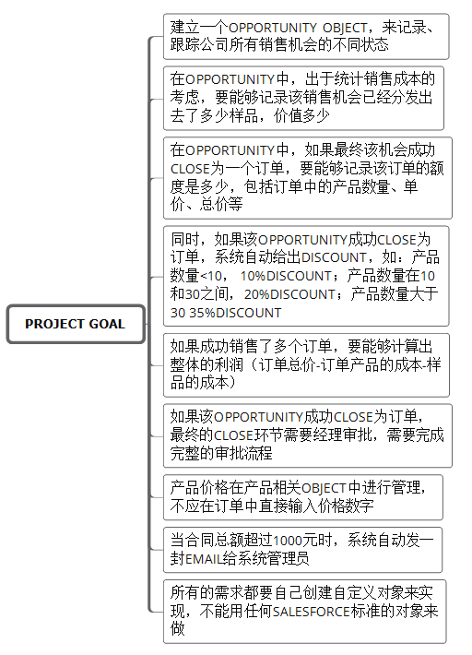
Project Goal
Business Case:
I run an organization that sells 3 products, blue, red, and green gift boxes. We are targeting stores in shopping malls to use our gift boxes for gift wrapping their merchandise. Our sales people call and visit stores at the malls talking to store owners about our boxes. To help the sales efforts, our sales people carry sample boxes that they distribute to store owners that show some interest.
Notes:
After analyzing our business case, we summarized there are 9 goal to finish for this project.

Slide 7
目 录
CONTENTS
Salesforce Introduction
Project Summary
Project Solution
Solution Detail

Slide 8
System Logic For This Case
APP
Veeva Sales
Contract_C
Order_C
Opportunity_C
Account_C
Product_C
Price_C
Object
Six Customized Objects
Notes:
following on the Salesforce IT architechture basic rules. We created six customized objects in Cloud Platform layer, and create a‘Veeva sales’ APP in Cloud APP layer.

Slide 9
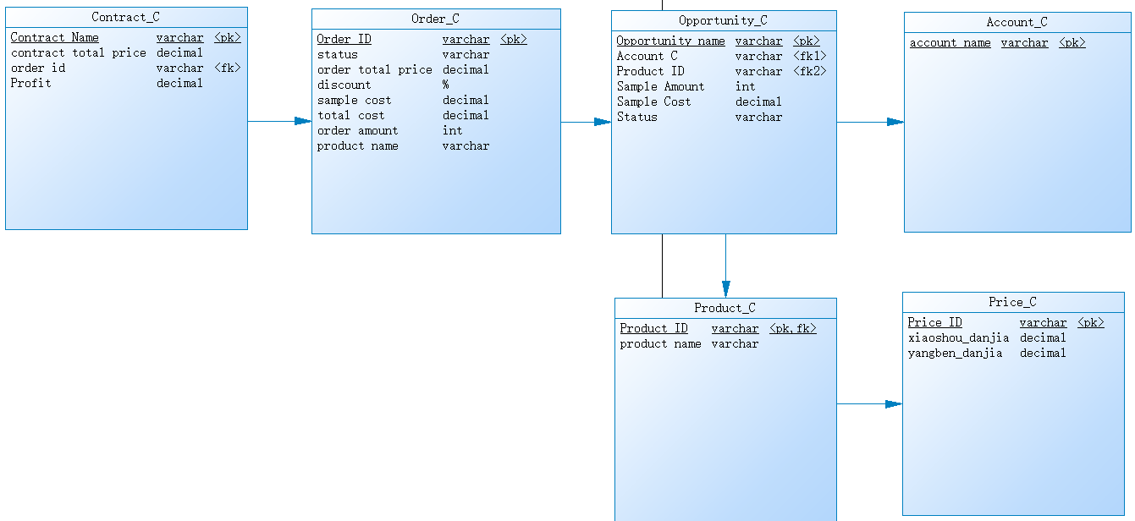
Objects Design Logic
Notes:
object is very similar to a database table in the salesforce platform
1、Price_C: to store Sample Unit price and Sales Unit price data(we manage product price here);
2、Product_C: to save Product name;
Here We make a relationship betwen Price_C and Product_C;
3、Account_C: to save Account name(save our customer detailed data);
4、Opportunity_C: to save Opportunity name, Account C, Product ID, Sample Amount(input), Sample Cost(formular), Status(value: in progress/close
won/close lost);
Here we make relationship with Account_C and Product_C;
Opportunity_C is used to record and track all the sales opportunities with different status. And we calculate sample cost and keep it as part of the total cost.
5、Order_C: we only see close won records from the opportunity_C
sample cost =from Opportunity_C.sample cost=price_C.yangben_danjia * price_C.sample amount;
Total cost = order amount * price_C.yangben_danjia(here we see sample unit price as equals to cost unit price);
order total price = order amount * price_C.xiaoshou_danjia;
Discount = if order amount less than 10， then we have 10% discount；if order amount between 10 and 30，then we have 20% discount；if order amount more than 30, then we have 35% discount;
6、Contract_C: we only see close won records from the Order_C
Contract total price = order total price * (1 – order_C.discount)
Profit = Contract total price – order_C.total cost – order_C.sample cost;

Slide 10
目 录
CONTENTS
Salesforce Introduction
Project Summary
Project Solution
Solution Detail

Slide 11
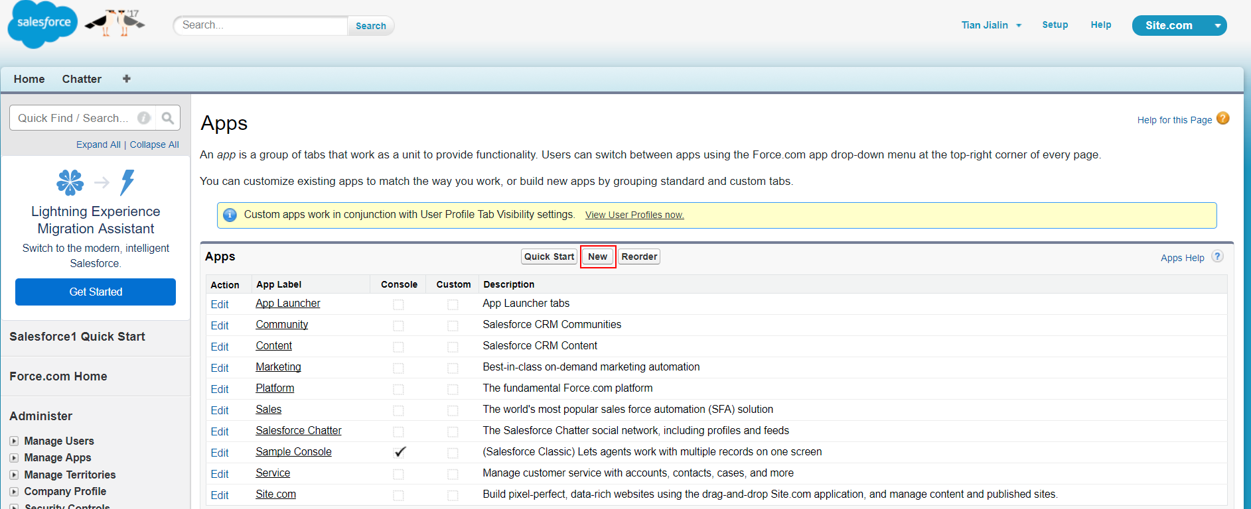
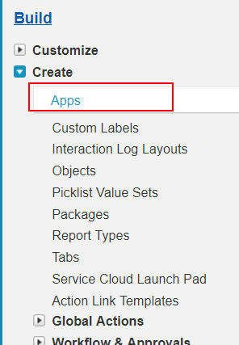
Create “Veeva Sales” APP - 1

Slide 12
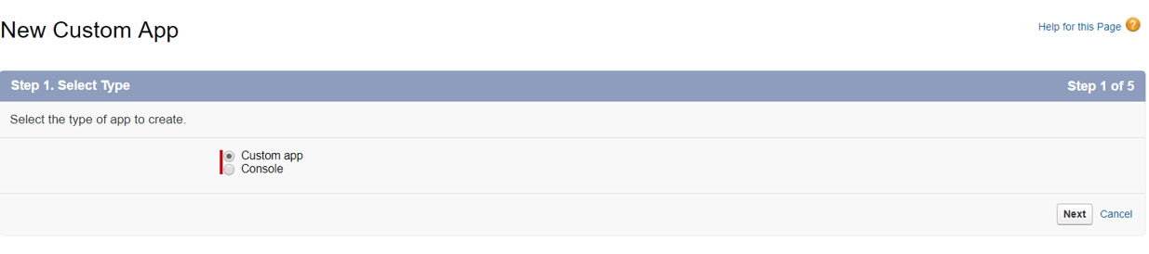
Create “Veeva Sales” APP - 2

Slide 13
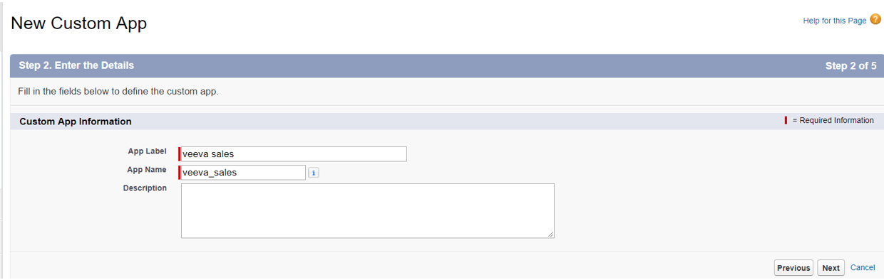
Create “Veeva Sales” APP - 3

Slide 14
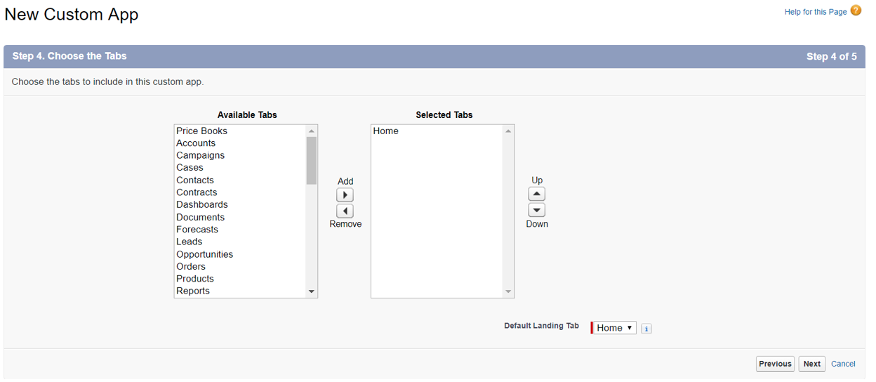
Create “Veeva Sales” APP - 4

Slide 15
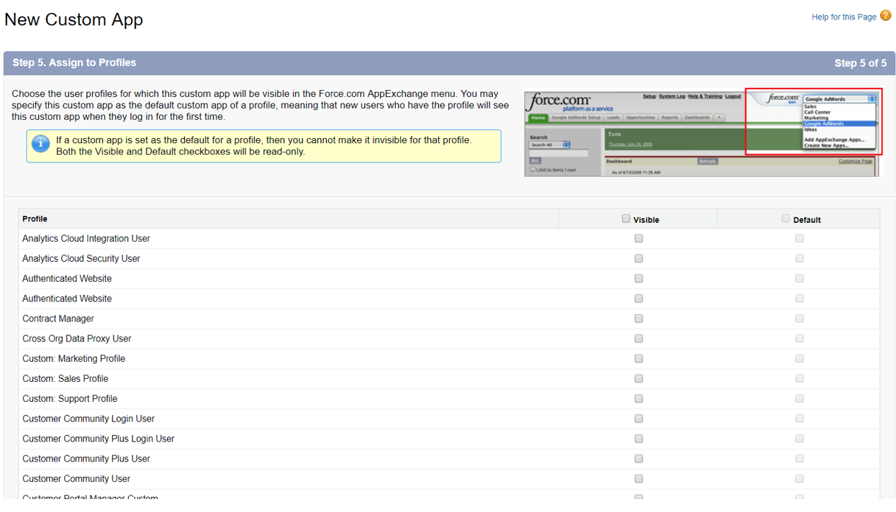
Create “Veeva Sales” APP - 5

Slide 16
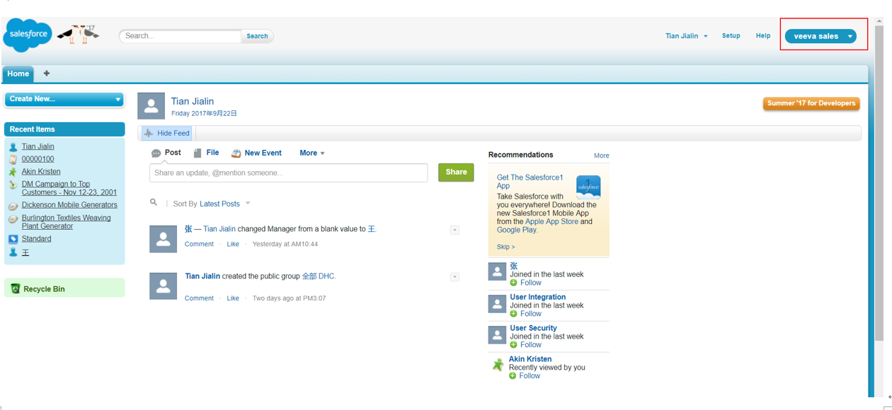
Create “Veeva Sales” APP - 6
Finally we finished!

Slide 17
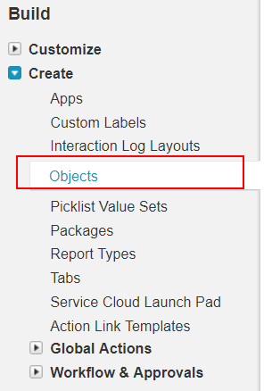
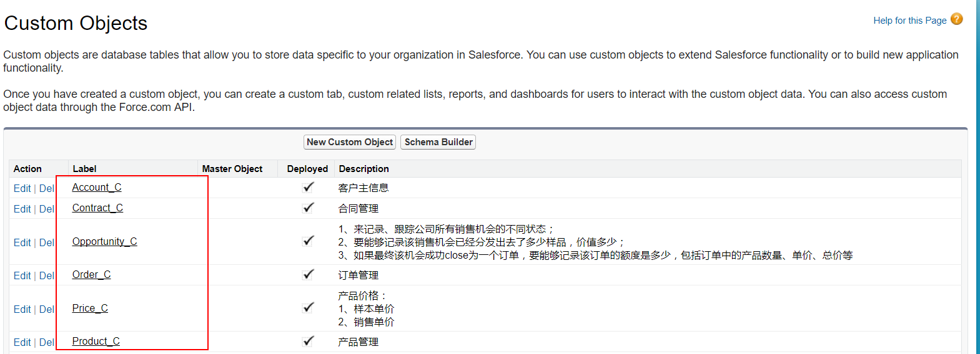
Create six Objects
Here we skip the Object creation steps!
We got six customized Objects as we mentioned before
Notes:
1、所有的需求都要自己创建自定义对象(Object_C)来实现，不能用任何Salesforce标准的对象来做;

Slide 18
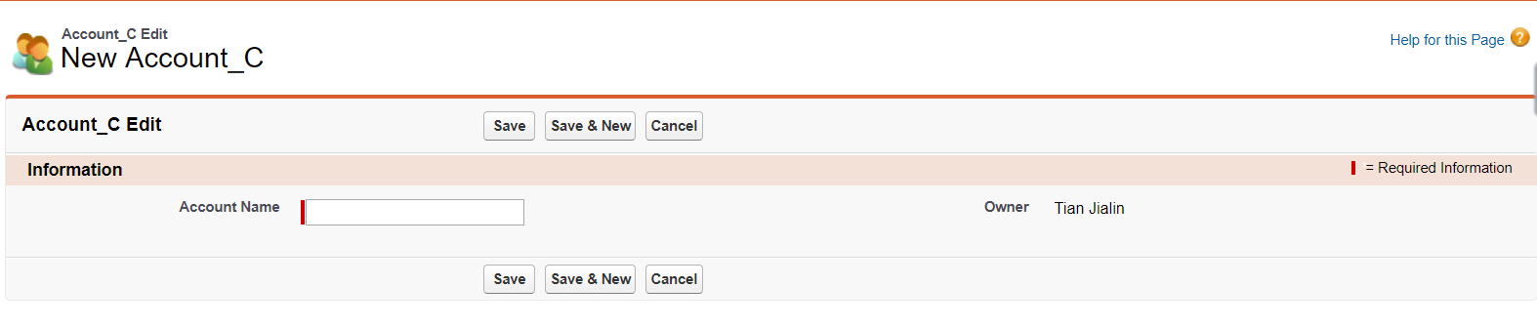
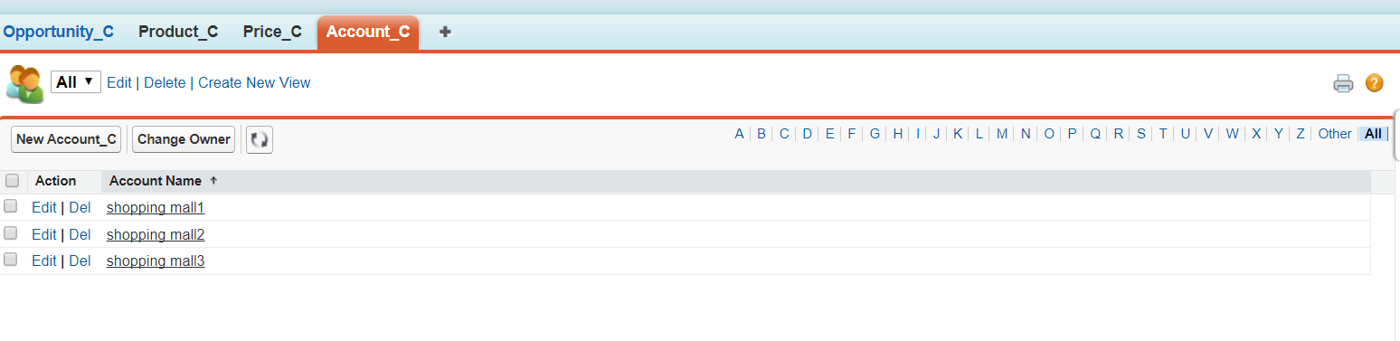
Demo – Create Account_C

Slide 19
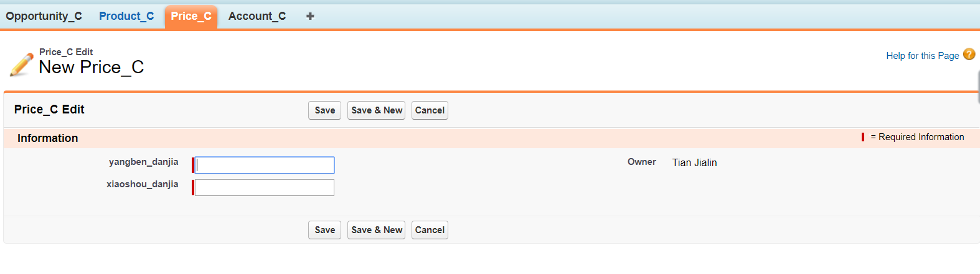
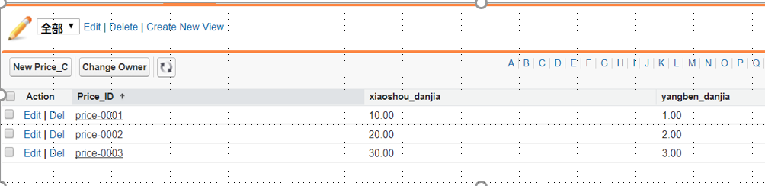
Demo - Create Price_C
Notes:
1、产品价格在产品相关object中进行管理，不应在订单中直接输入价格数字

Slide 20
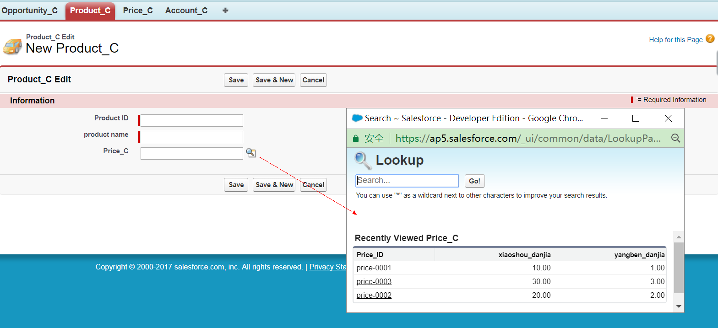
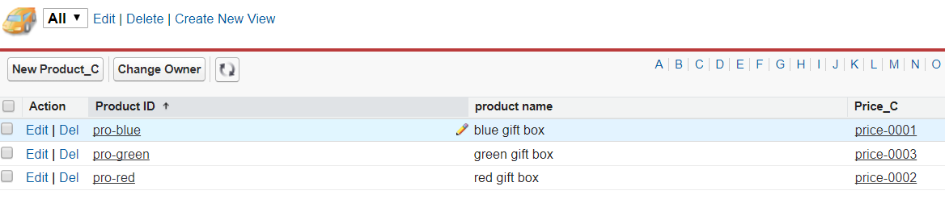
Demo – Create Product_C

Slide 21
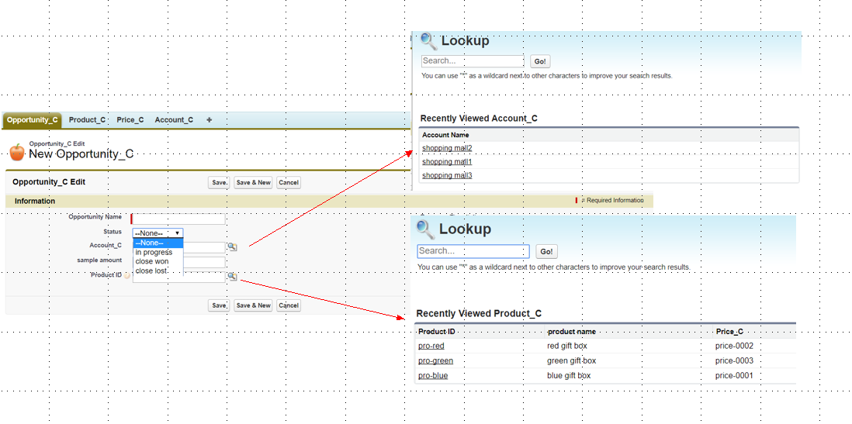
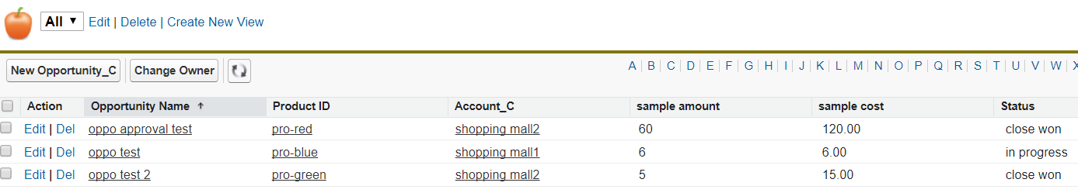
Demo – Create Opportunity_C
Notes:
1、建立一个opportunity object，来记录、跟踪公司所有销售机会的不同状态（Status）；
2、在opportunity中，出于统计销售成本的考虑，要能够记录该销售机会已经分发出去了多少样品（sample amount），价值多少（sample cost）；
3、订单只能查询opportunity-status：close won 状态下的数据；

Slide 22
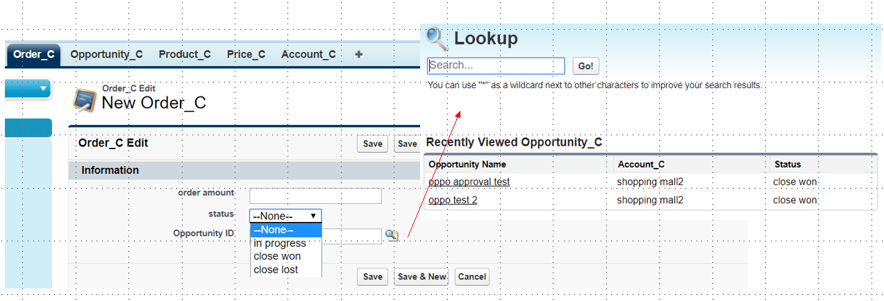
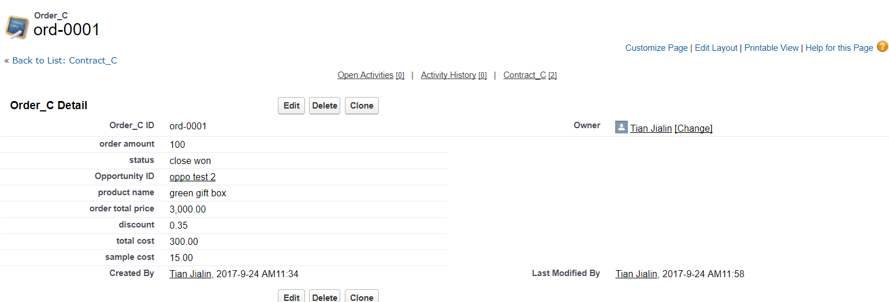
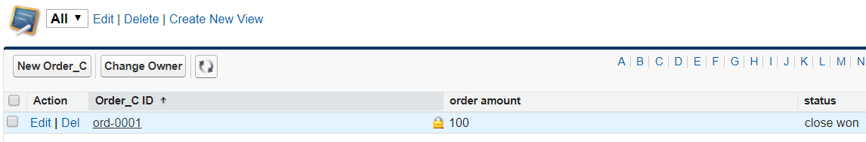
Demo – Create Order_C
Notes:
1、在opportunity中，如果最终该机会成功close为一个订单 （status: close won），要能够记录该订单的额度是多少(order total price)，包括订单中的产品数量(order amount)、单价(xiaoshou_danjia)、总价(order total price)；
2、同时，如果该opportunity成功close为订单，系统自动给出discount，如：产品数量<10， 10%discount；产品数量在10和30之间，20%discount；产品数量大于30 35%discount；
3、如果该opportunity成功close为订单，最终的close环节需要经理审批，需要完成完整的审批流程（后面部分单独介绍）

Slide 23
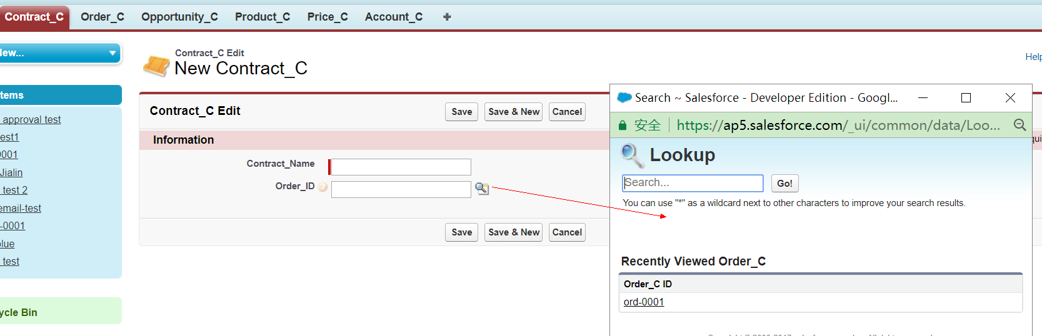
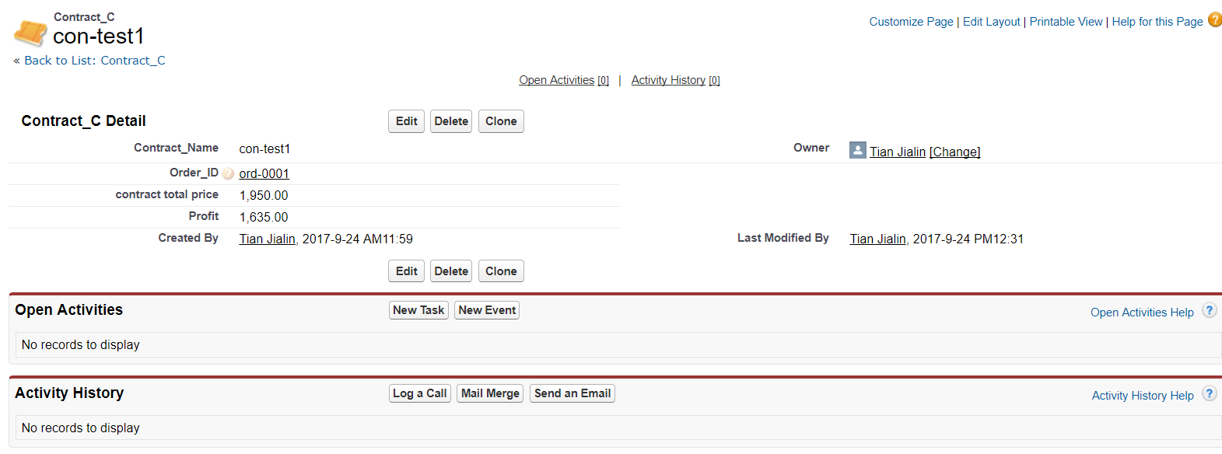
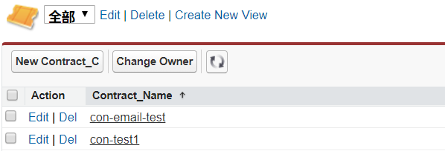
Demo – Create Contract_C
Notes:
1、如果成功销售了多个订单(order status: close won)，要能够计算出整体的利润（Profit）（订单总价(contract total price)-订单产品的成本(total cost)-样品的成本(sample cost)）;
2、当合同总额超过1000元时，系统自动发一封email给系统管理员（后面单独介绍）；

Slide 24
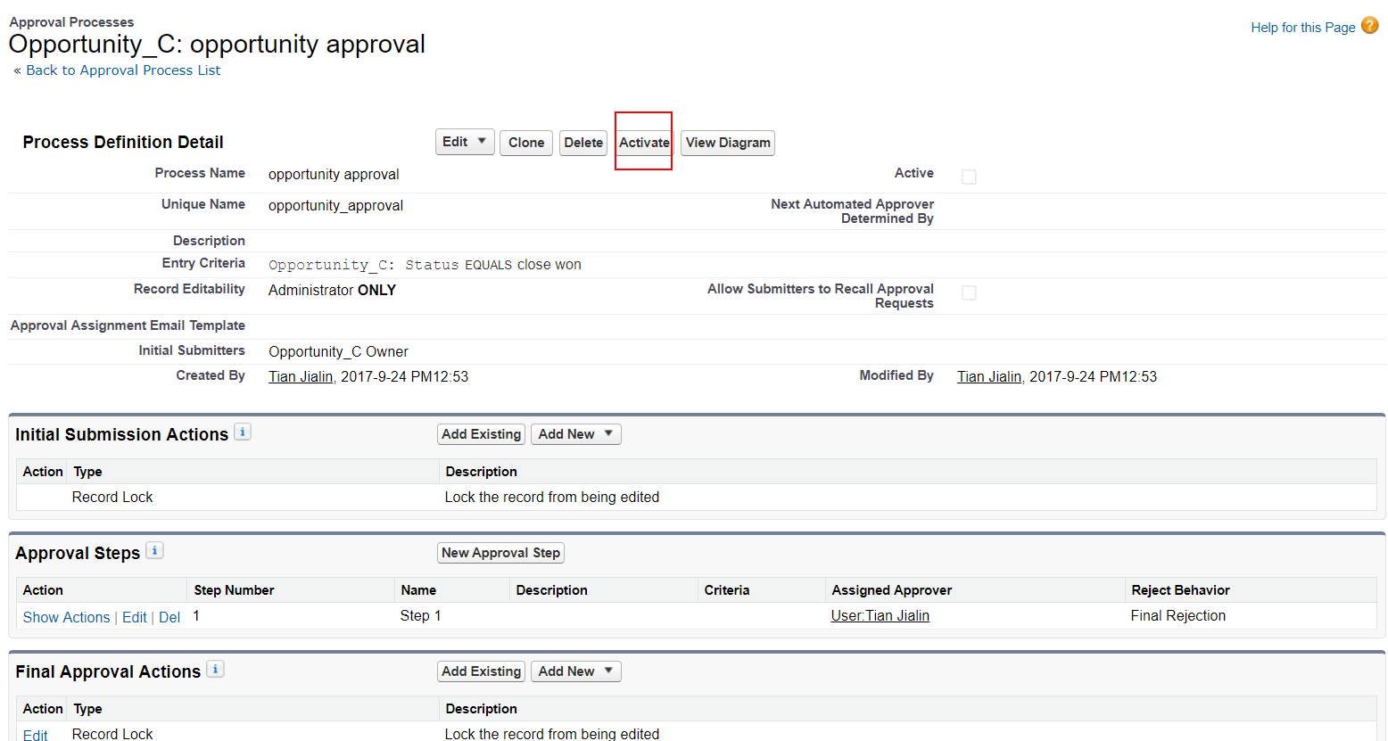
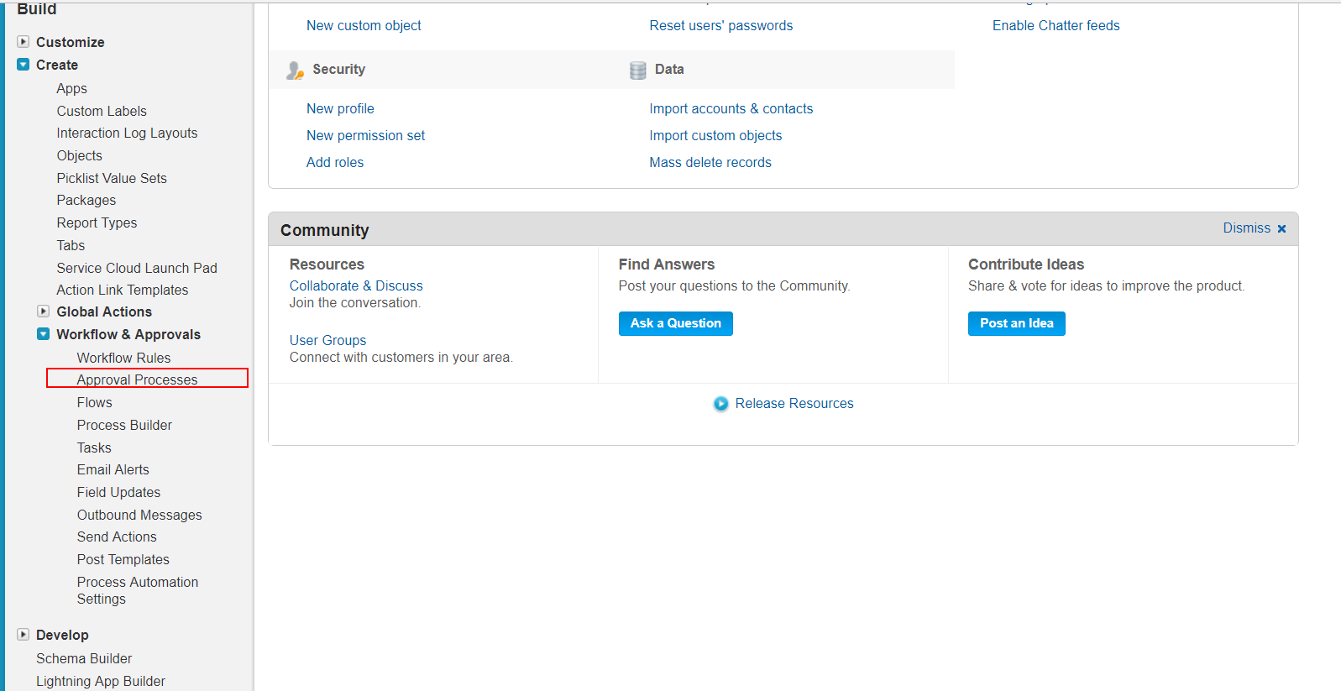
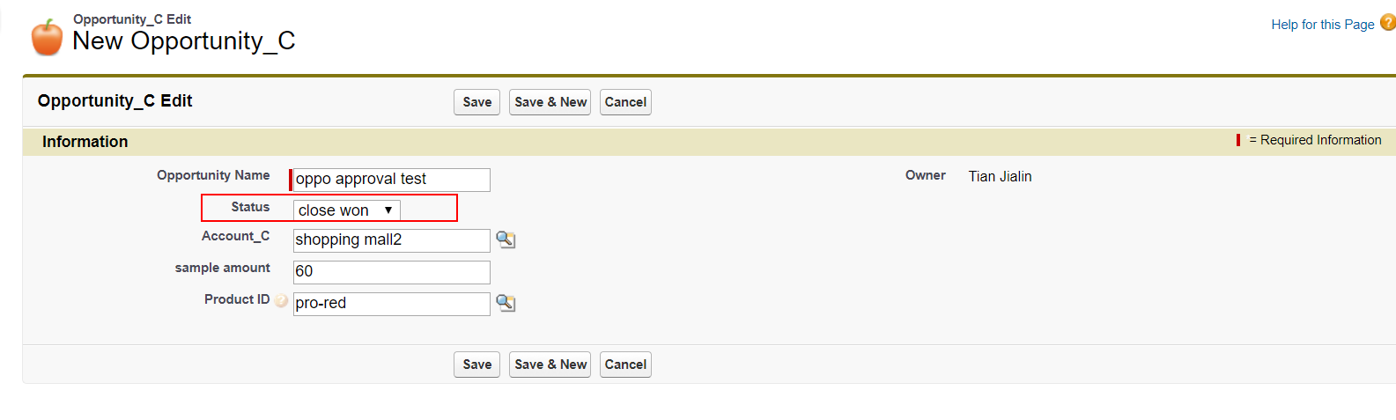
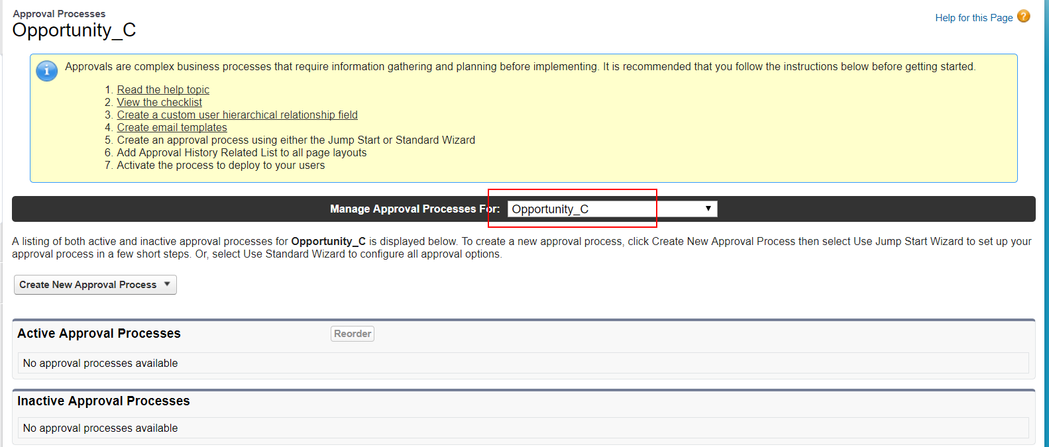
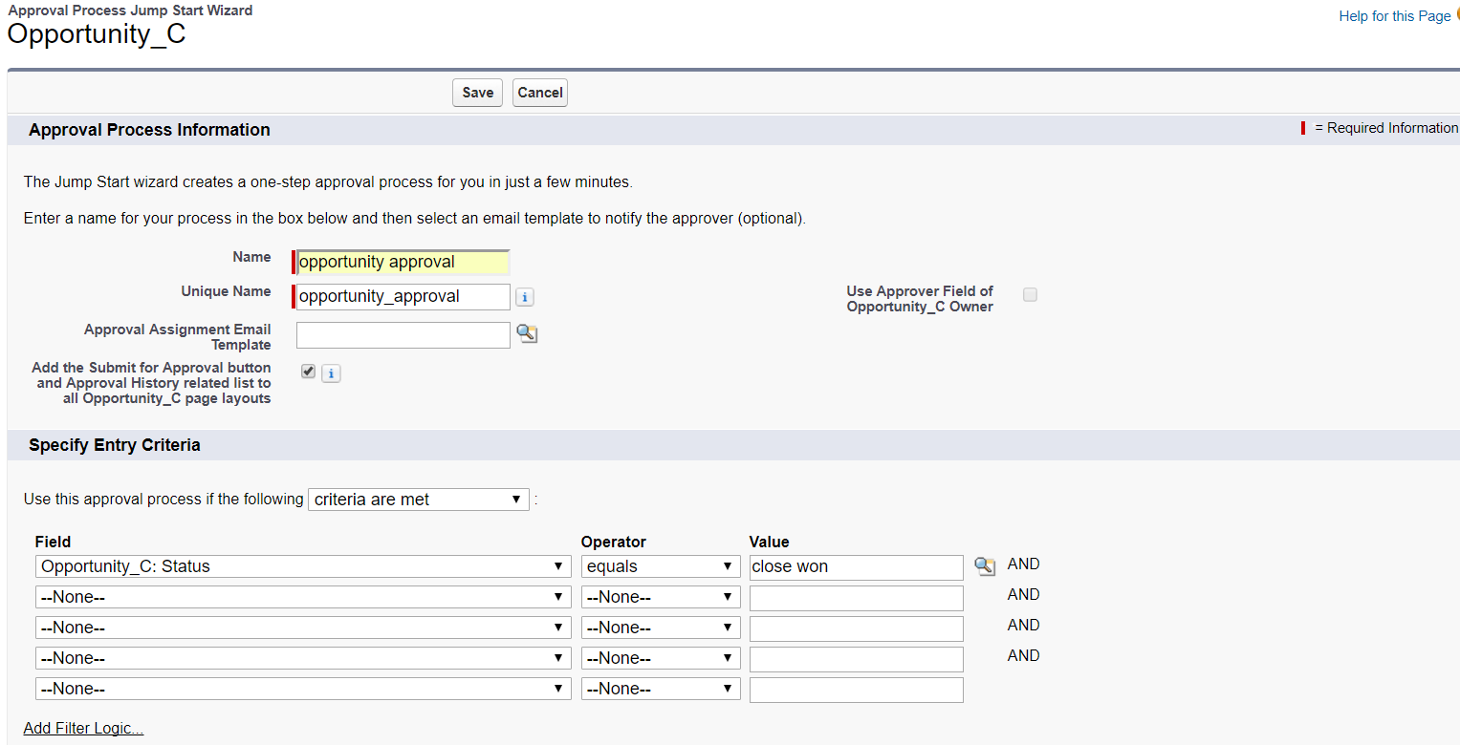
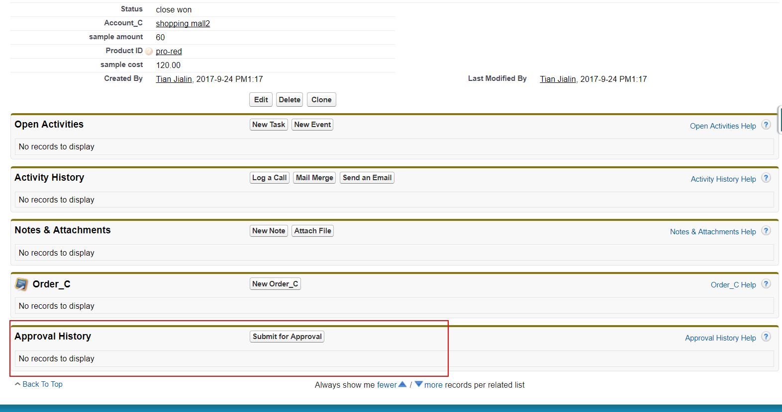
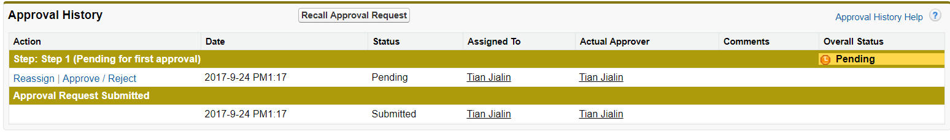
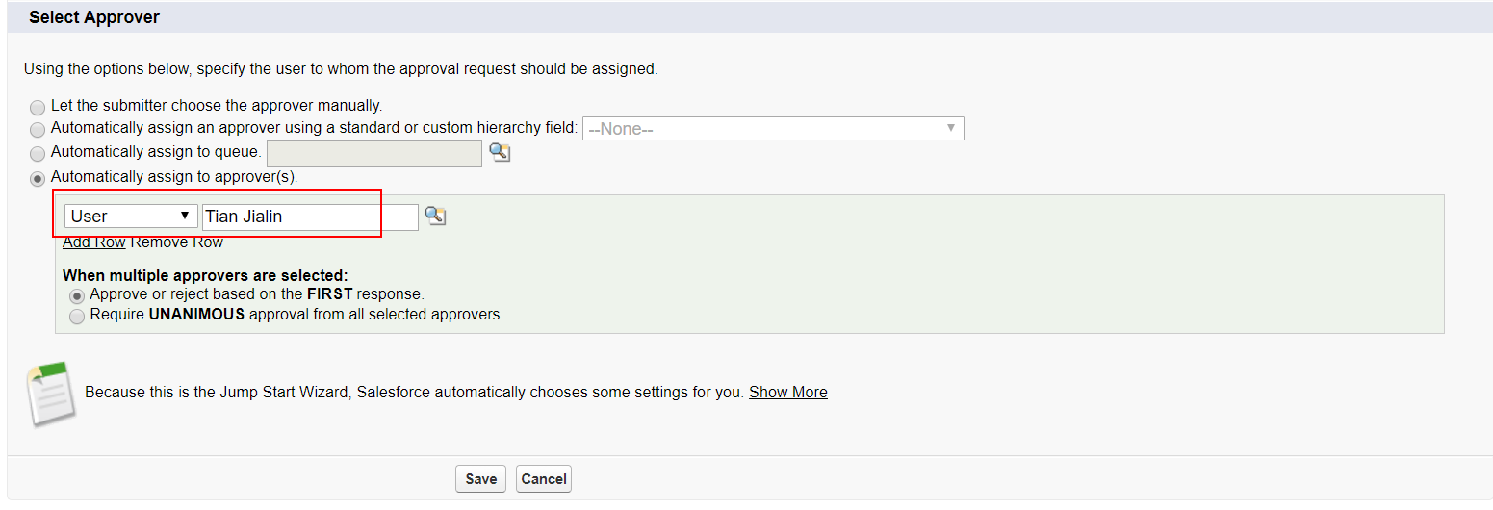
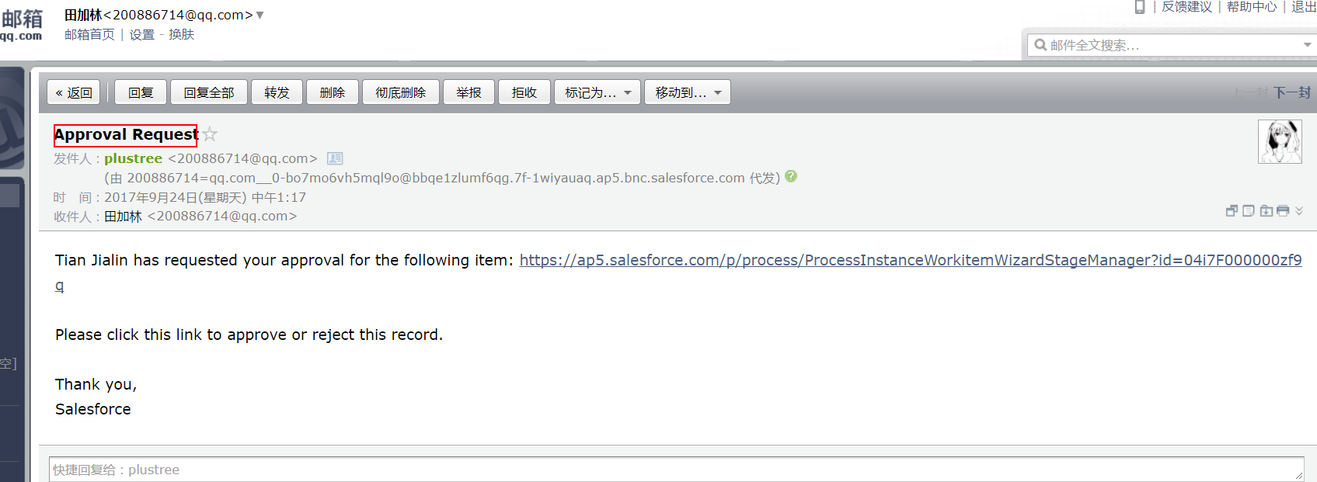
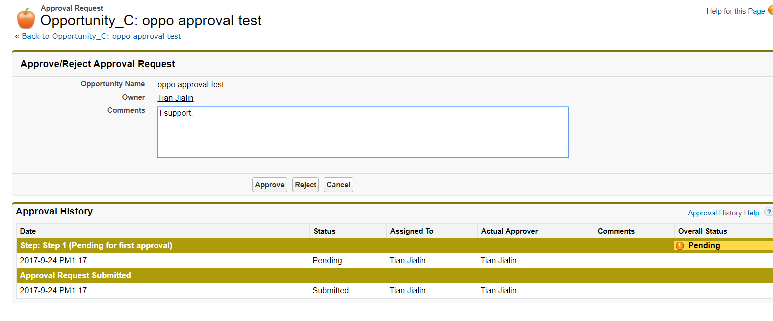
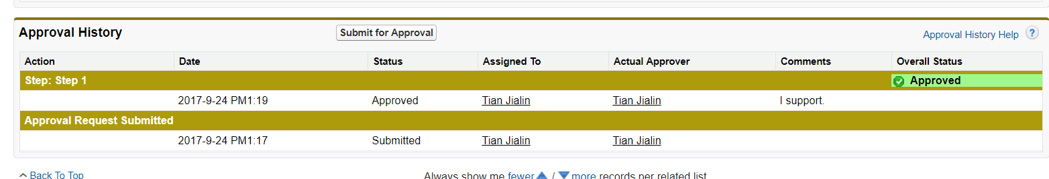
Approval Processes
Notes:
1、if the opportunity close won，it needs further manager’s approval process;
（请连续动画播放）

Slide 25
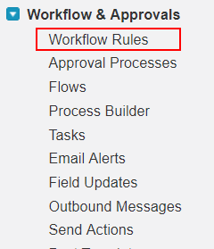
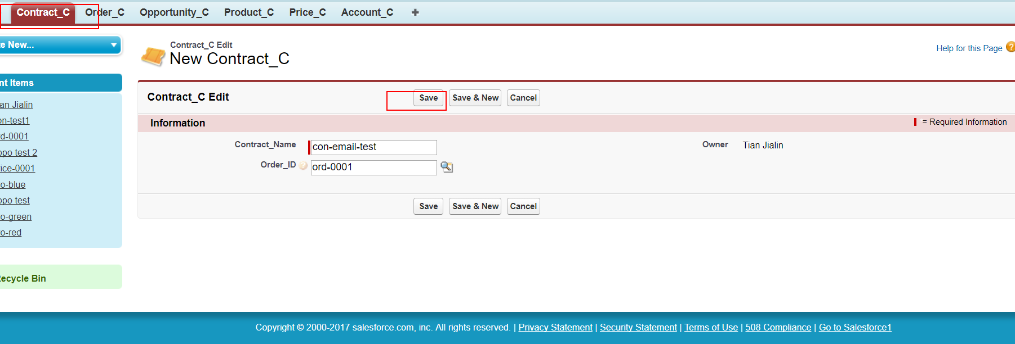
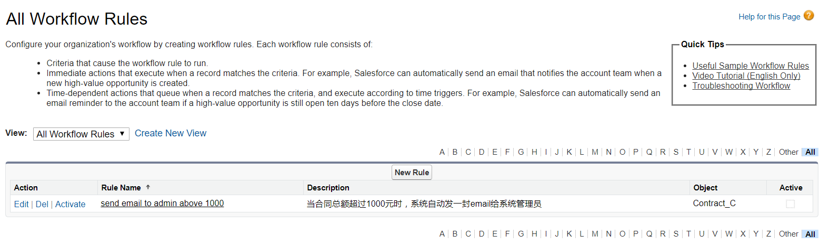
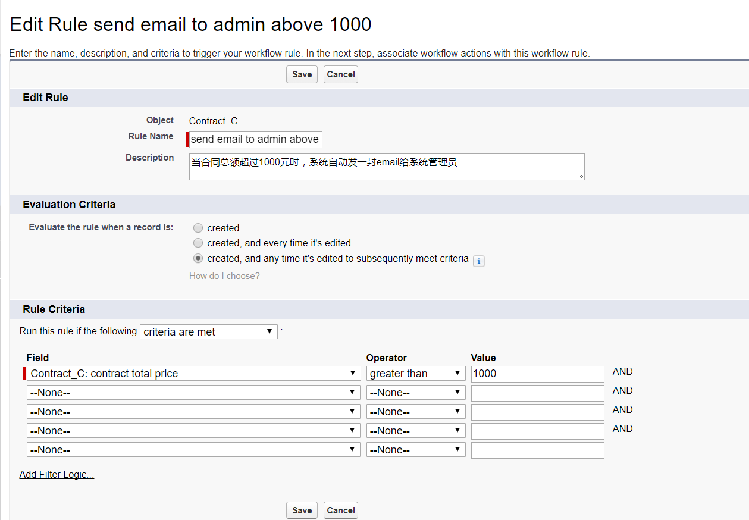
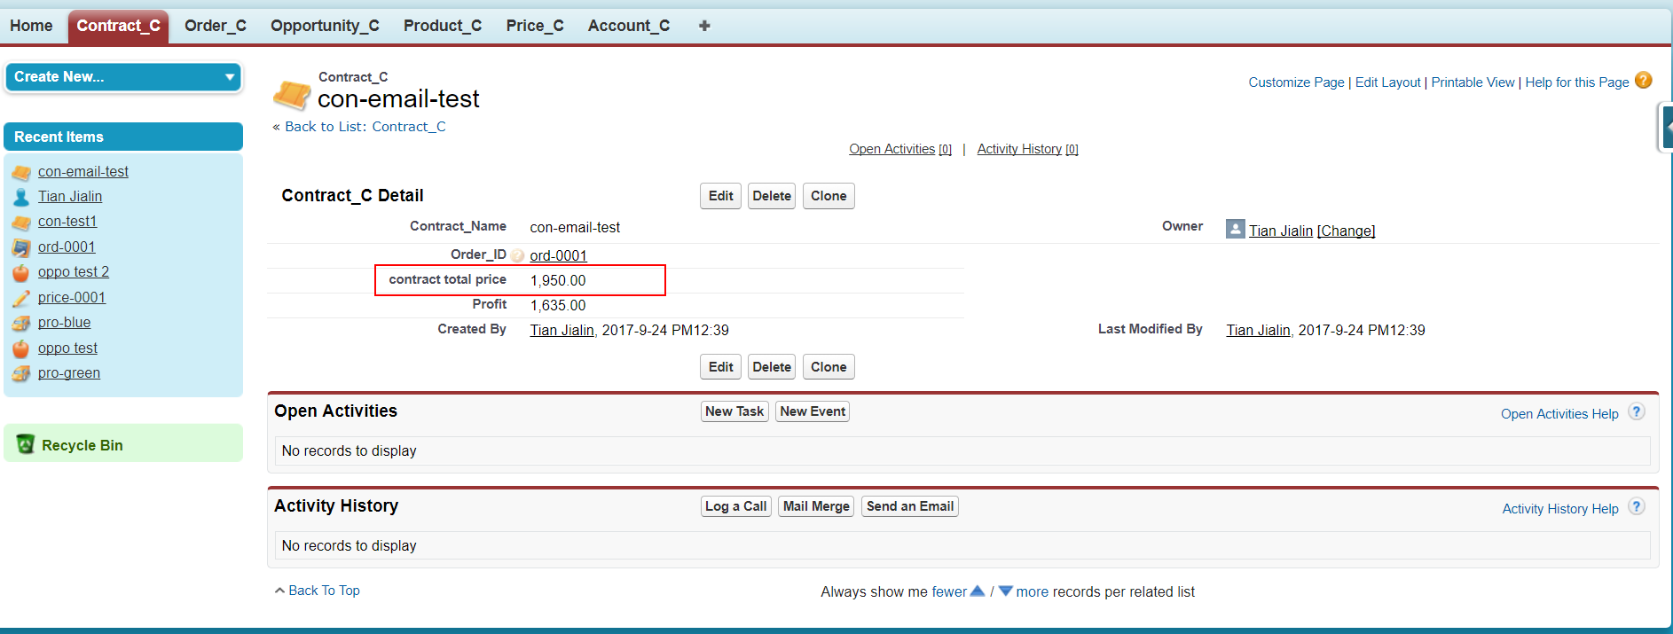
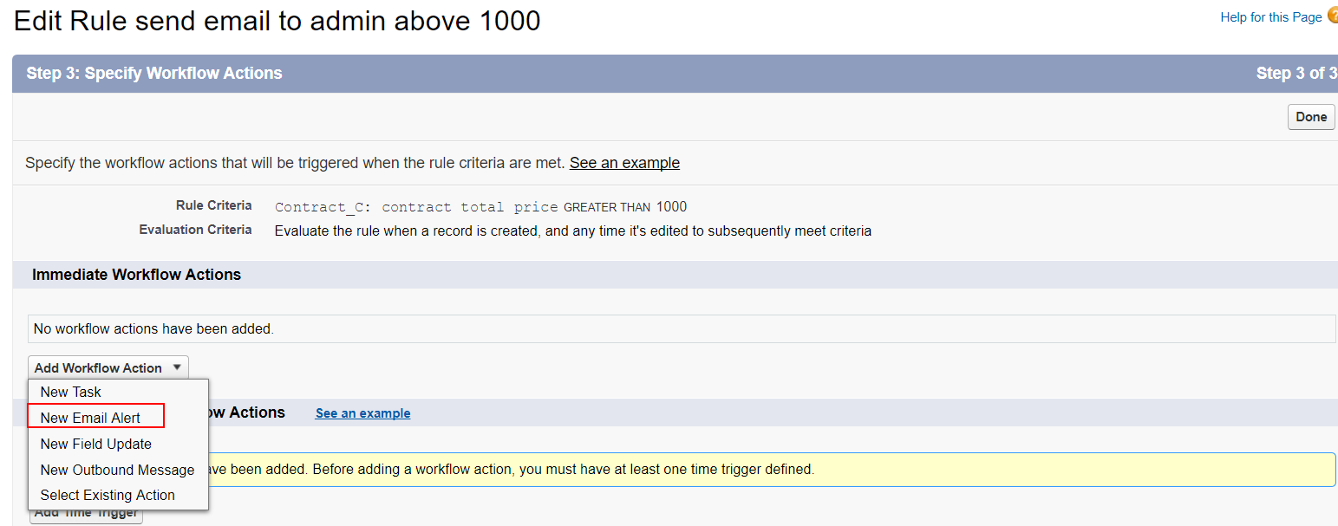
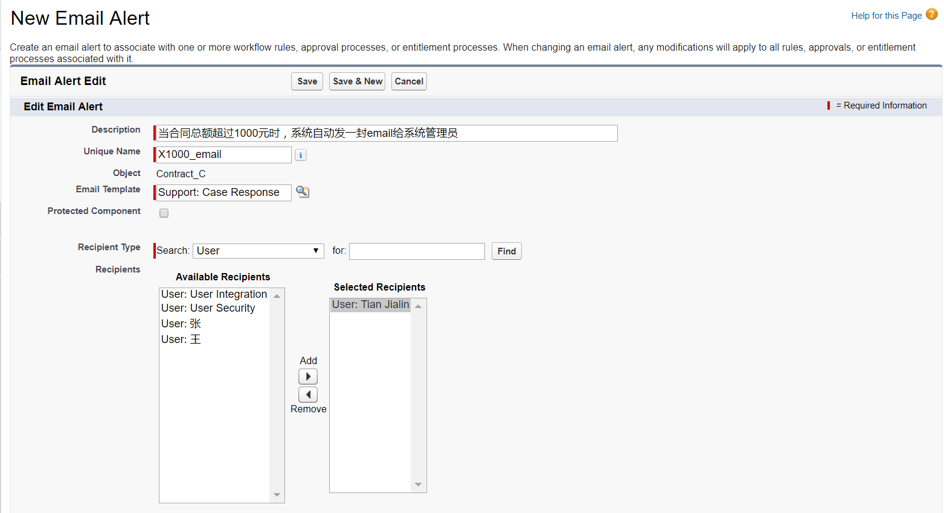
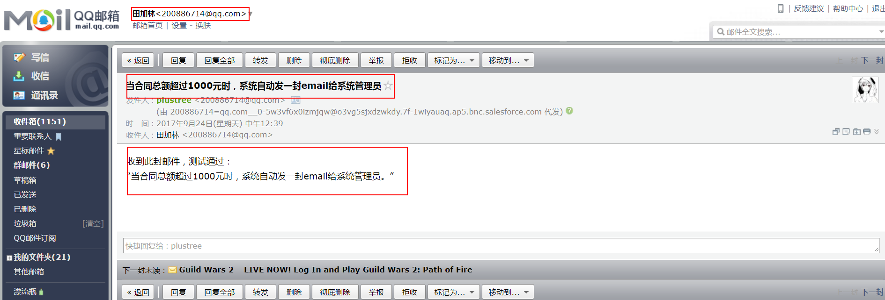
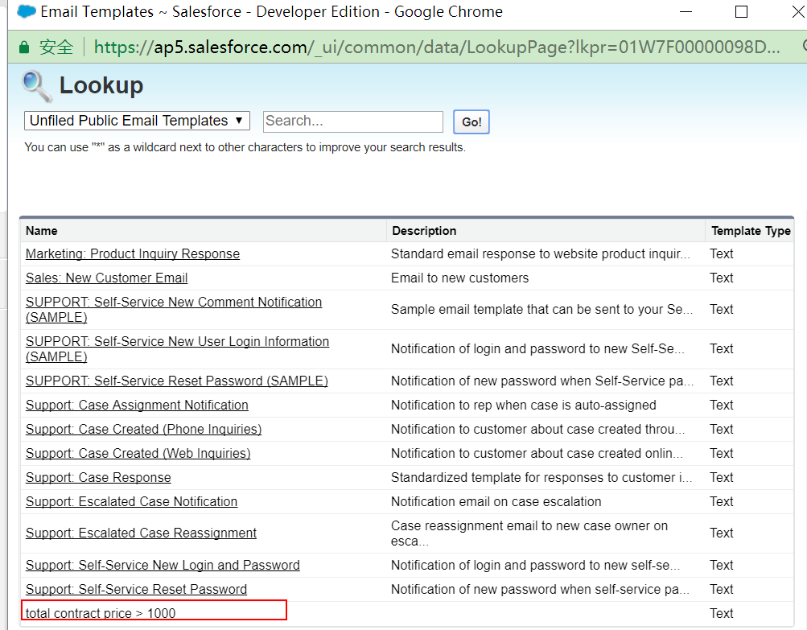
Workflow Rules
Notes:
When total contract sales amount is above one thousand, system will automatically send email to administrator.

Slide 26
感谢聆听！
Thanks！

